Slide 1
Nuclear performing to meet growing clean energy demand
Agneta Rising Director General
Toronto Global Forum
11 December 2018

Slide 2
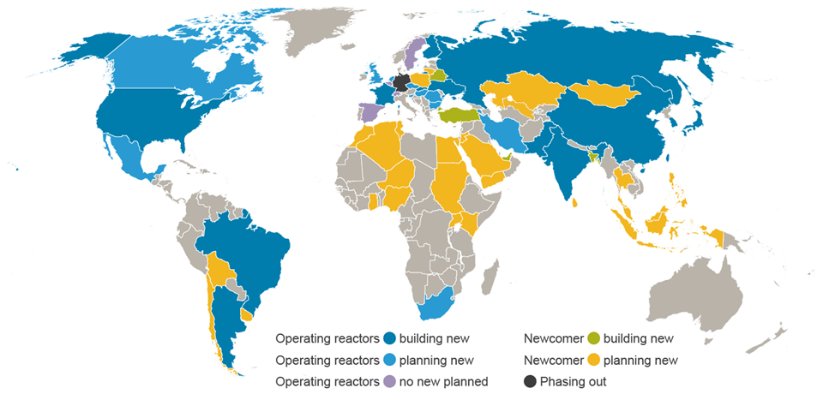
New build and new countries

Slide 3
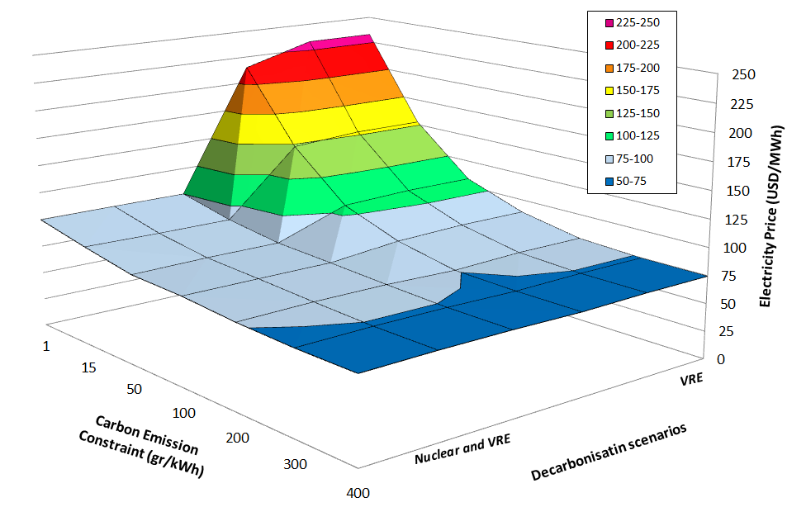
Nuclear and renewables together reduce decarbonization costs
MIT study (2016)* shows that full decarbonization is achievable thanks to a mix of nuclear and renewables.
But it shows that the cost of decarbonization increases exponentially with the share of intermittent renewables, given decarbonization constraints.
* MIT 2016 – Decarbonization of Power Systems: Analyzing Different Technological Pathways
Results for ERCOT – Elec Reliability Council of Texas

Slide 4
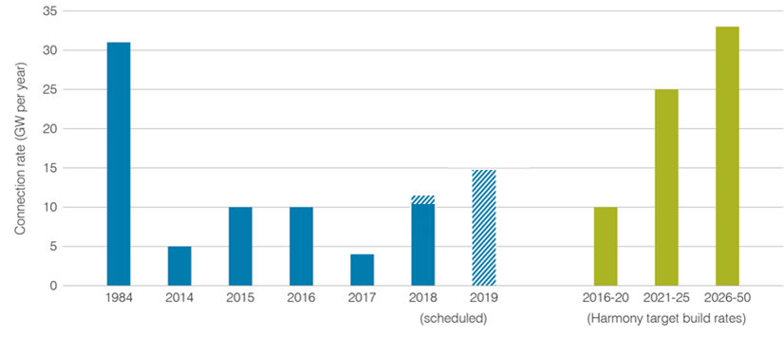
Harmony programme 2016-2050 Cumulative 1000 GW new nuclear capacity to 2050
Construction rate doubled from trend of 5GW/y or less to 10GW/y
Then we need to triple from today’s level
Period Connection rate Added capacity
GW per year GW
2016-2020 10 50
2021-2025 25 125
2026-2050 33 825
_________________________________
Total new nuclear capacity 1000 GW
Notes:
Title: Harmony programme 2016-2050 Deliver 1000 GW new nuclear capacity to 2050
Summary:
The Harmony goal is to have 1000 GWe of new nuclear build by 2050.
This is an ambitious programme, but the rate at which new reactors will have to be built is no higher than what has been historically achieved
The build rate required to meet the Harmony goal of 1000 GWe of new nuclear capacity by 2050 is: • 10 GWe per year between 2016 and 2020 • 25 GWe per year between 2021 and 2025 • 33 GWe per year between 2026 and 2050
Globally, the industry has met the target required in 2015 and 2016.
However, a significant acceleration in new nuclear build is now required.

Slide 5
Harmony
What will power our electric future?

